Slide 1
V MODEL
JAYANT PATIL

Slide 2
Definition of V Model
The V-model is a type of SDLC model where its phases executes in V-shape . It is also known as Verification and Validation model.
It is based on the association of a testing phase for each corresponding development stage.
Development of each step directly associated with the testing phase. The next phase starts only after completion of the previous phase i.e. for each development activity, there is a testing activity corresponding to it.

Slide 3
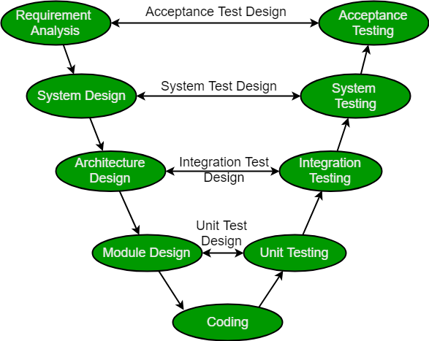
Validation
Verification

Slide 4
Verification
It involves static analysis technique (review) done without executing code. It is the process of evaluation of the product development phase to find whether specified requirements meet.
Validation
It involves dynamic analysis technique (functional, non-functional), testing done by executing code. Validation is the process to evaluate the software after the completion of the development phase to determine whether software meets the customer expectations and requirements.
So V-Model contains Verification phases on one side of the Validation phases on the other side. Verification and Validation phases are joined by coding phase in V-shape. Thus it is called V-Model.

Slide 5
Design Phase:
1] Requirement Analysis
2] System Design
3] Architectural Design (High level design)
4] Module Design (Low level design)
Testing Phases:
1] Unit Testing
2] Integration testing
3] System Testing
4] Acceptance Testing

Slide 6
Industrial Challenge
Accurately define and refine user requirements.
Design and build an application according to the authorized user requirements.
Validate that the application they had built adhered to the authorized business requirements.
Why preferred?
It is easy to manage due to the rigidity of the model. Each phase of V-Model has specific deliverables and a review process.
Proactive defect tracking – that is defects are found at early stage.
When to use?
Where requirements are clearly defined and fixed.
The V-Model is used when ample technical resources are available with technical expertise.

Slide 7
Advantages:
This is a highly disciplined model and Phases are completed one at a time.
V-Model is used for small projects where project requirements are clear.
Simple and easy to understand and use.
This model focuses on verification and validation activities early in the life cycle thereby enhancing the probability of building an error-free and good quality product.
It enables project management to track progress accurately.
Disadvantages:
High risk and uncertainty.
It is not a good for complex and object-oriented projects.
It is not suitable for projects where requirements are not clear and contains high risk of changing.
This model does not support iteration of phases.
It does not easily handle concurrent events.

